Slide 2
Xooma’s Guide
on
How to Protect & Strengthen
Your Immune System*
*The information contained in this presentation is for educational purposes only and has not been evaluated by the FDA. The name brand products referenced are not intended to diagnose, treat, cure or prevent any disease.

Slide 3
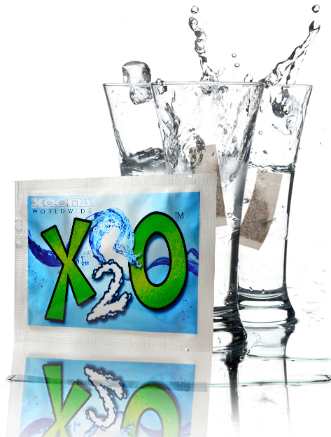
Hydration / Minerals / Alkalinity

Slide 4
HYDRATION A strong immune system requires proper daily hydration. Chronic dehydration leads disease & illness.
Xooma’s X2O transforms plain water into a powerful hydration beverage
Increased cellular hydration allows vital nutrients to be delivered more effectively throughout the body
Increased cellular hydration ensures that your lymphatic system has the lubrication needed to detoxify and drain impurities

Slide 5
MINERALS
Xooma’s X2O contains 70+ trace minerals
Minerals are essential for human health and immune system strength, yet the majority of our society is mineral deficient due to unhealthy lifestyle habits
Dr. Linus Pauling, 2-time Nobel Prize winner, illustrated the importance of minerals by saying this, “Every ailment, every sickness and every disease can be traced back to mineral deficiency in the body.”

Slide 6
ALKALINITY
Xooma’s X2O provides a strong boost of alkalinity to your water which supports a stronger immune system
Dr. Arthur Guyton, author of “Textbook of Medical Physiology”, illustrated the importance of this by saying, “The cells of a healthy body are alkaline while the cells of a diseased body are acidic.”
Acidic foods & beverages (modern lifestyles) lead to acidic conditions in the body which can often lead to a weaker immune system

Slide 7
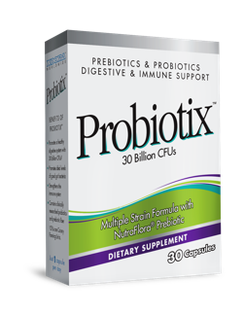
‘Gut Health’ – A critical factor in keeping your immune system strong

Slide 8
Did you know?
60-80% of your entire immune system is located in your digestive tract
Your intestines are home to 500 million bacteria
According to the National Institute of Diabetes, Digestive and Kidney Diseases (NIDDK), as many as 70 million Americans are now affected by digestive diseases.

Slide 9
Probiotics to the rescue!
Top benefits include…
Strengthen immune system
Improve digestion & nutrient absorption
Improve sleep
Reduce allergy symptoms
Promote weight loss

Slide 10
Xooma’s Probiotix supplement offers:
Exclusive formula based in real science & research
High CFU Count (colony forming units) / 30 Billion CFUs
Strain diversity/ 8 key probiotic strains
Acid and bile resistant
Just 1 capsule per day
Affordable pricing & honest value

Slide 11
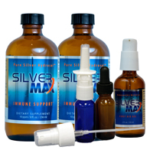
Silver – The forgotten Answer

Slide 12
The ancient cultures of Egypt, Greece, Macedonia, Phoenicia and Rome, all relied on silver to keep them well.
During the Middle Ages, upper class Europeans used silver utensils and goblets, ensuring the safety of their food and water.
In America’s “Old West,” it was common practice to drop silver coins into drinking water barrels for protection against water-borne illness.
As recently as the 1930’s, silver was the preferred choice of physicians for empowering the immune system and supporting the body’s innate healing processes.

Slide 13
Xooma’s Silver MAX – Time tested wisdom made better through modern technology
Anti-BACTERIAL
Anti-FUNGAL
Anti-VIRAL

Slide 14
Xooma’s Silver MAX is…
Safe & effective
Scientifically supported
99.99% pure
Actively charged (bio-active)
Easily absorbed
A great value (a little goes a long way)

Slide 15
Available in liquid & topical gel, Silver MAX is used for:
Immediate immune system threats
Long-term immune support
Internal/oral consumption
External skin application for protection & healing
Eye, ear & nasal application

Slide 16
WAIT!
What’s on that surface you just touched?

Slide 17
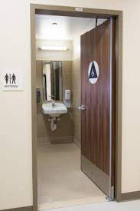

Slide 18
Insta Protex
Non-toxic, eco-friendly, ant-bacterial, anti-fungal and anti-viral cleaner & sanitizer

Slide 19
Insta Protex Benefits
Long Lasting: Remains effective on surfaces for up to 14 days after application!
Fast Acting - Sanitizes within 1 minute of application.
Safe enough to be used on skin: Can be used as a hand sanitizer. Forms an invisible shield on hands that lasts long after initial application.
Eco-Friendly: Water-based solution that does not contain toxic chemicals. Re-usable spray bottles also reduce plastic waste and minimizes the impact to our environment.

Slide 20
Insta Protex Benefits
Multi-Purpose: Effective on hard and soft surfaces. Spray, swab, rub or soak contaminated surfaces, including plastic, wood, stone, leather, cloth, fabric/clothing, glass and metal.
High Efficacy: Effective against a wide spectrum of bacteria, fungi & viruses.
Independent Lab Tested & Verified: Proven safe & effective in independent laboratory tests. ASTM E1053 tested (Coronavirus Test) for 99.9% effectiveness.

Slide 21
Protect your health and
strengthen your immune system!
Make Xooma’s X2O, Probiotix, Silver MAX & Insta Protex part of your daily routine

